Slide 1
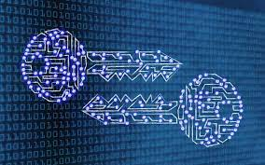
Quantum Cryptography Project
The New Age of Security

Slide 2
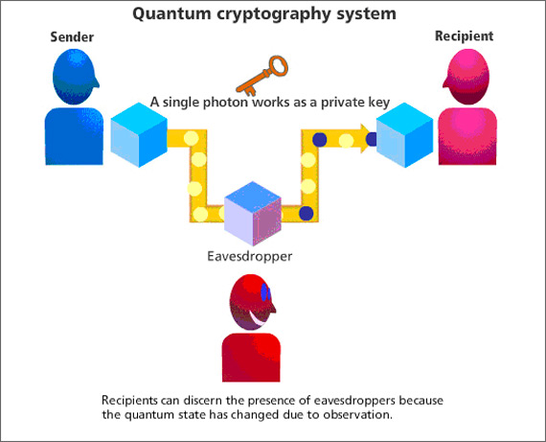

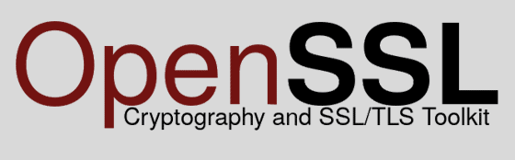

Slide 3
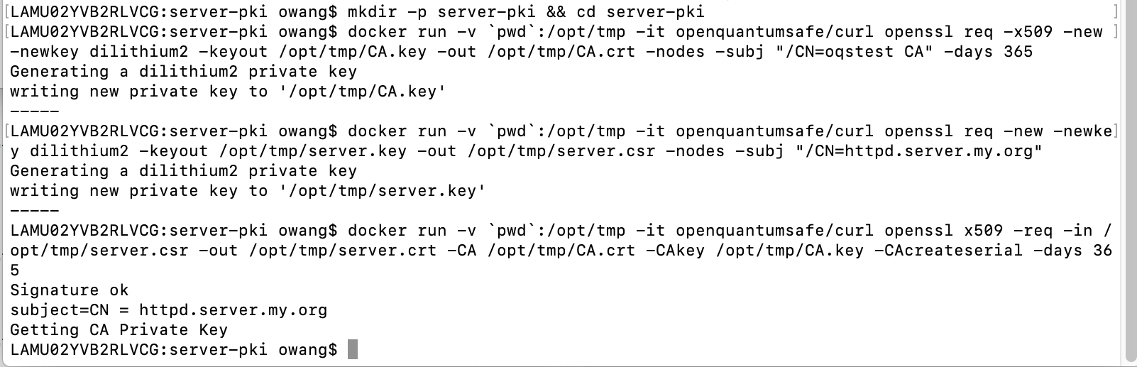
1.
2.
3.
4.
Make directory for keys and certificates
CA key and certificate
Server key
Server certificate

Slide 4
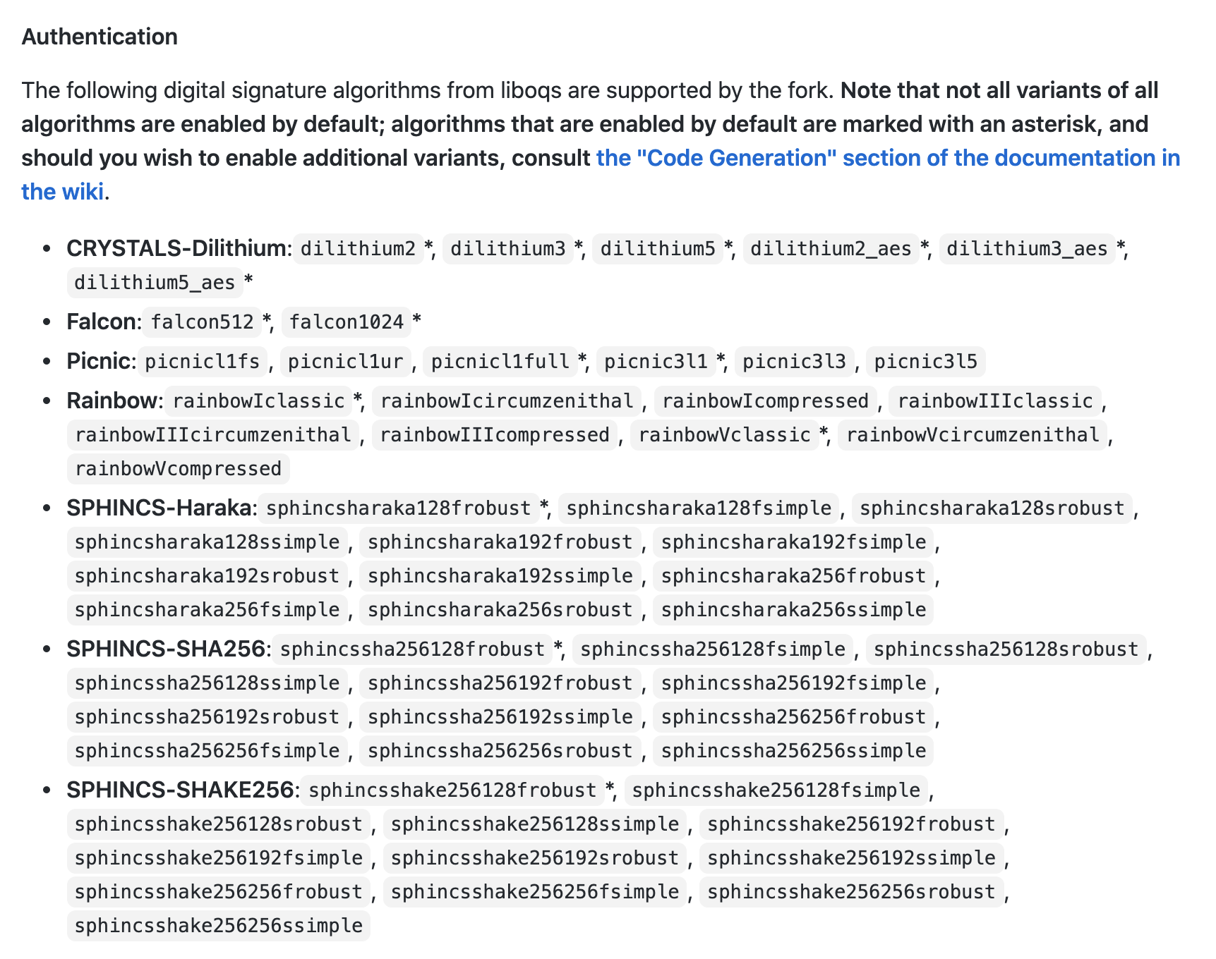
Algorithms
NIST Finalists
CRYSTALS-DILITHIUM
FALCON
RAINBOW

Slide 5
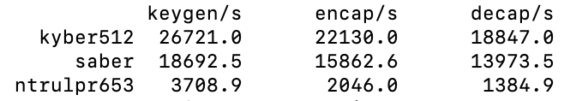
Performance

